Slide 1
CS 2009 Design and Analysis of Algorithms
NP-Completeness Intro
Thomas H. Coreman (CLRS), Chapter 34.

Slide 2
WHAT WE’LL COVER TODAY
Easy Vs. Hard Problems
P Vs. NP Problems
NP-Hard vs NP-Complete
Difficulty level of various complexity groups.

Slide 3
Easy vs. Hard Problems (Oversimplification)
An oversimplification of the “easy vs. hard” dichotomy proposed by
the theory of NP-hardness is:
Easy Problems can be solved with a polynomial-time algorithm;
Hard Problems requires exponential time in the worst case.

Slide 4
Polynomial-Time Algorithms
A polynomial-time algorithm is an algorithm with worst-case running time O(n^{d}), where n denotes the input size and d is a constant (independent of n).:
Example:
Problems | Algorithm | Running Time
Sorting | MergeSort | O(n log n)
Strong Components | Kosaraju | O(V + E)
Shortest Paths | Dijkstra | O((V+ E) log V)
MST | Kruskal | O((V+ E) log V)
All-Pairs Shortest Paths | Floyd-Warshall | O(n³)

Slide 5
Easy Problems (Polynomial-Time Solvable)
The theory of NP-hardness defines “easy” problems as those solvable by a polynomial-time algorithm.

Slide 6
Hard Problems
“Hard” problems as family of problems for which no polynomial-time Algorithm known to exist.
The theory of NP-hardness shows that thousands of computational problems (including the TSP) are variations of the same problem in disguise, all destined to suffer identical computational fates.
NP-Hard (Formal Definition)
A computational problem is NP-hard if every problem in NP reduces to it.

Slide 7
P vs NP Problems?
P problems: (The original definition) Problems that can be solved by deterministic Turing machine in polynomial-time.
NP problems
(The original definition) Problems that can be solved by non-deterministic Turing machine in polynomial-time.
(A equivalent definition) Problems that are verifiable in polynomial time.
Given a solution, there is a polynomial-time algorithm to tell if this solution is correct.

Slide 8
NP Problems
NP = {Decision problems solvable in polynomial time via a “lucky” algorithm}. The “lucky” algorithm can make lucky guesses always “right” without trying all options.
Stage 1 Non-deterministic model (Guessing): algorithm makes guesses.
Stage 2: Deterministic (“verification”) says YES or NO () guesses guaranteed to lead to YES outcome if possible (no otherwise).
NP Problems: verification stage is polynomial

Slide 9
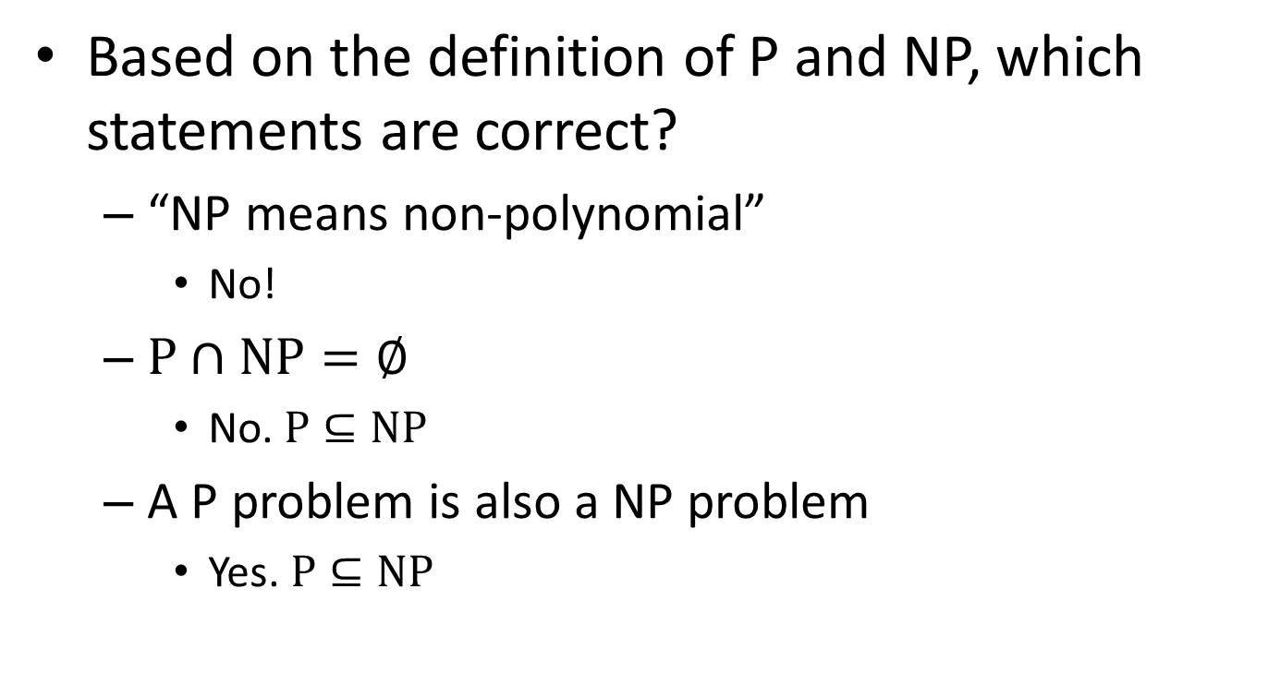
What are P and NP?
Based on the definition of P and NP, which statements are correct?
“NP means non-polynomial”
No!
$P∩NP=∅$
No. $P⊆NP$
A P problem is also a NP problem
Yes. $P⊆NP$

Slide 10
What are P and NP?
any problem solvable by a deterministic Turing machine in polynomial time is also solvable by a nondeterministic Turing machine in polynomial time. Thus, P ⊆ NP
P = NP means whether an NP problem can belong to class P problem. In other words whether every problem whose solution can be verified by a computer in polynomial time can also be solved by a
computer in polynomial time

Slide 11
What are P and NP?
In order to prove that P ≠ NP, we would need to prove that there exists a set of problems X such that:
X falls in NP. There exists an algorithm with which a nondeterministic Turing machine could solve problems in X in polynomial time
X does not fall in P. There exists no algorithm whatsoever with which a deterministic Turing machine could solve problems in X in polynomial time

Slide 12
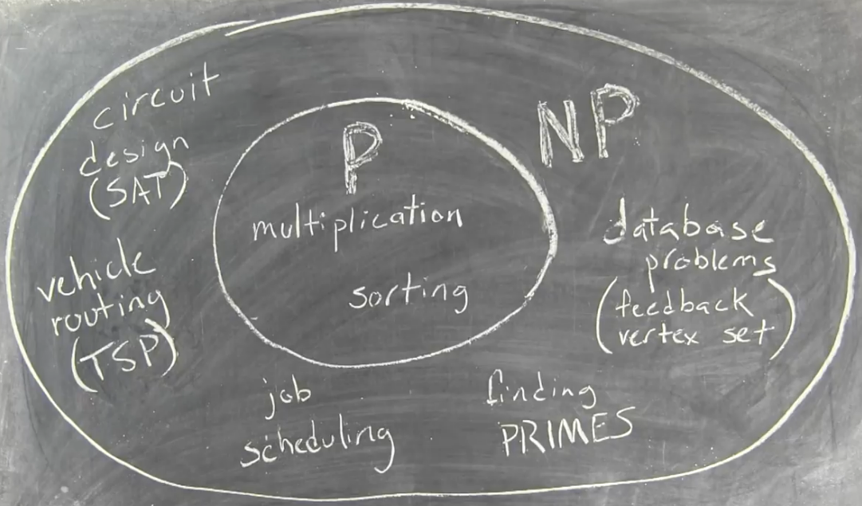
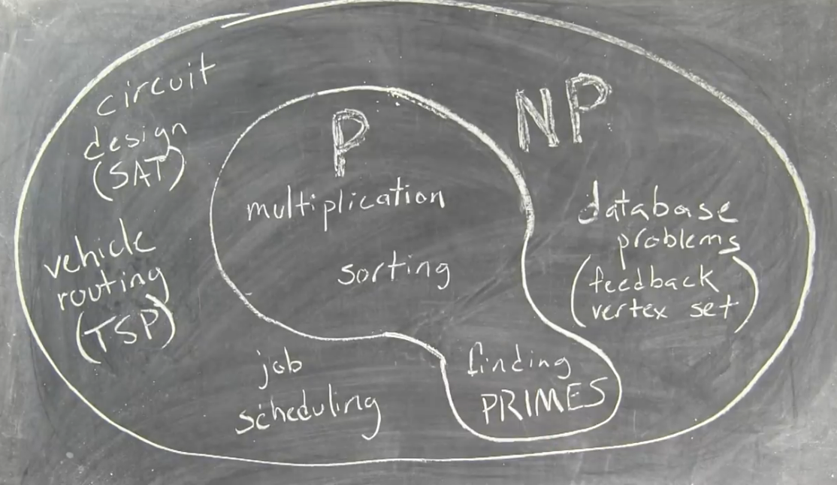

Slide 13
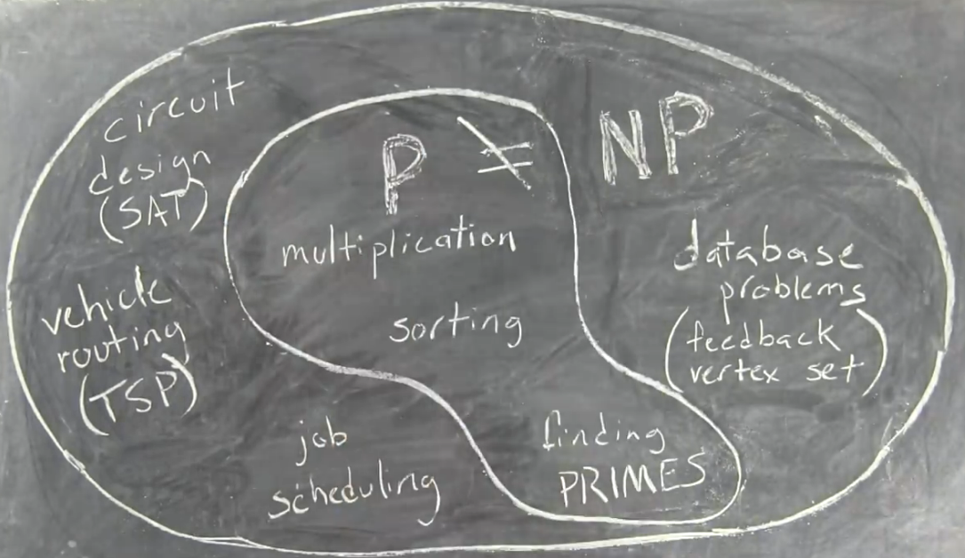
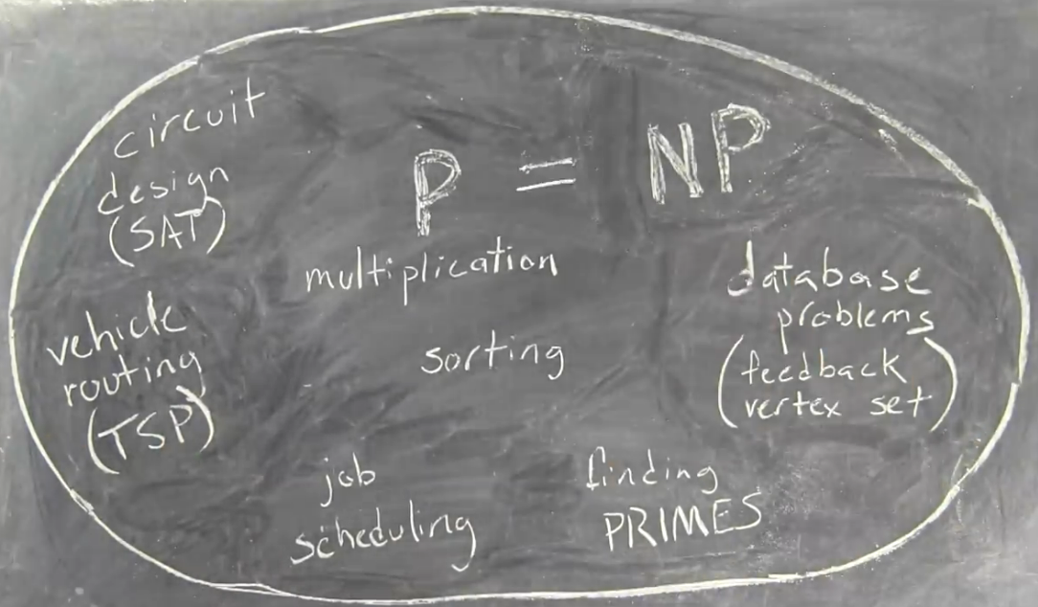
Most scientists believe:
However, it is not ruled out that:

Slide 14
NP Hard vs NP-Completeness
A problem B is NP-complete if:
(1) B ∈ NP
(2) A ≤_{p} B for all A ∈ NP
If B satisfies only property (2) we say that B is NP-hard.
(NP-hard may or may not be in NP)
(NP-complete must be in NP and if every problem in NP reduces to it.
So far, No polynomial time algorithm has been discovered for an NP-Complete problem
No one has ever proven that no polynomial time algorithm can exist for any NP-Complete problem
NP-complete
P
NP

Slide 15
What are NP-complete problems?
Most scientists believe:
However, it is not ruled out that:
NP
NP=NPC=P
NPC
P
NP-Hard problems: problems harder than or equal to NPC problems

Slide 16
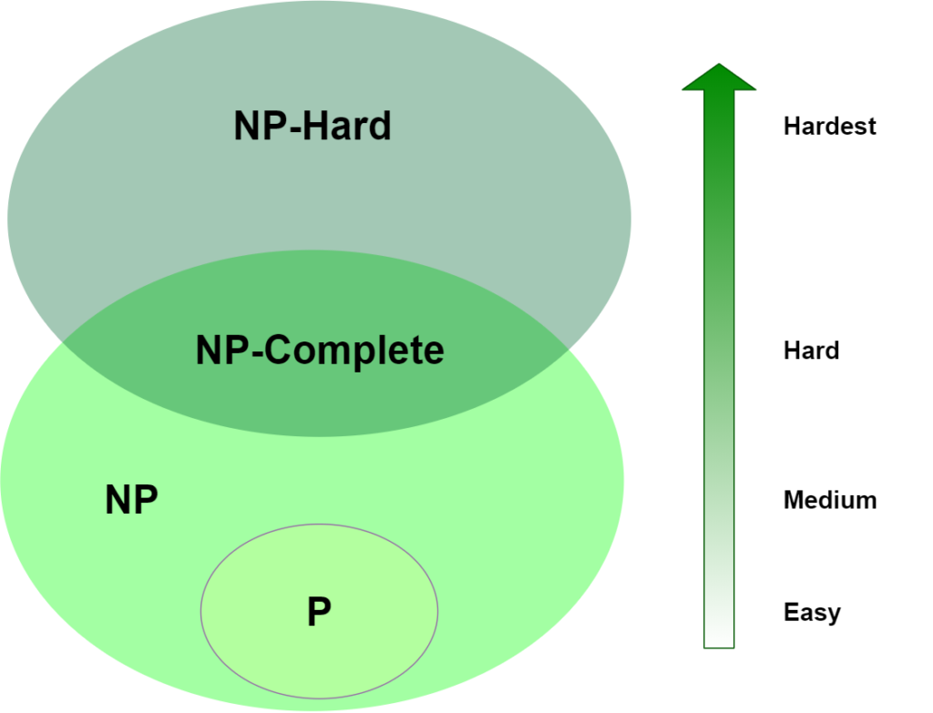
NP-Hard Region: Can be verified in P-time
NP-Hard Region: Even hard to check answer in P-time
TSP,
Halting Problem,
Best Chess move
Hamiltonian Cycle,
Maximum Clique,
Satisfibility
Factoring,
Graph isomorphism
Sorting,
Search Element,
Graph Connectivity
Notes:
NOW P=NP ? is the biggest question which is still unsolved. to solve this you have to prove either way given below
1.if P=NP then give solution for the algorithm in NP solved by deterministic algorithm (means possible in theory as well as in practice)in polynomial time
2.if not then prove that the algorithm in NP will take minimum exponential time to solve and it can not be solved in polynomial time by using deterministic algorithm.
The problem in NP-Hard cannot be solved in polynomial time, until P = NP. If a problem is proved to be NPC, there is no need to waste time on trying to find an efficient algorithm for it. Instead, we can focus on design approximation algorithm.

Slide 17
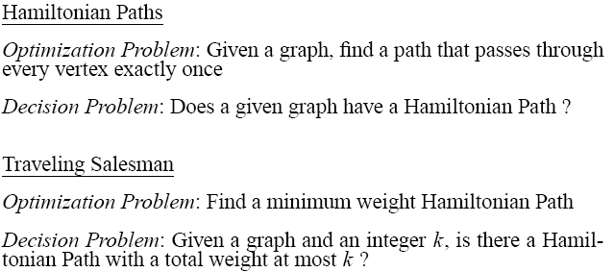
Examples NP-complete and NP-hard problems
NP-complete
NP-hard
Factoring and Graph isomorphism: are NP Problems which means we can verify solution in P time. But these problems still can not reduce to any existing NP-complete problem (so these problems are not hard as NP-complete problems) . Therefore may be in the computational complexity class NP-intermediate.
Notes:
NP-hard means “at least as hard as an NP-complete problem.“
NP-complete problems—for which no efficient solution is believed to exist.
(No polynomial Algo is known but it is also not proven that in future there will be no polynomial algorithm for NP complete.
So it is open-Question )
The graph isomorphism problem is the computational problem of determining whether two finite graphs are isomorphic.
Hardest Problem are those problem which even can not be verified in Polynomial

Slide 18
Why we study NPC?
For new computational problems we encounter:
We try for a while to develop an efficient algorithm; and if this fails,
We then try to prove it NP-complete.
Find Approximate Algorithms (sub-optimal solution) if required.
How to prove a problem is a NPC problem?

Slide 19
How to prove a problem is a NPC problem?
A common method is to prove that it is not easier than a known NPC problem.
To prove problem A is a NPC problem
Choose a NPC problem B
Develop a polynomial-time algorithm translate A to B
A reduction algorithm
If A can be solved in polynomial time, then B can be solved in polynomial time. It is contradicted with B is a NPC problem.
So, A cannot be solved in polynomial time, it is also a NPC problem.

Slide 20
Reduction
if any NP-complete problem can be solved in polynomial time, then every problem in NP has a polynomial-time solution.

Slide 21
What if a NPC problem needs to be solved?
Buy a more expensive machine and wait
(could be 1000 years)
Turn to approximation algorithms
Algorithms that produce near optimal solutions

